Slide 1






Master Thesis Collequim submitted as a partial requirement for the degree of:
M.Eng., Embedded Systems for Mechatronics
Author of the work:
Mustafa Özçelikörs
Supervision by:
M.Eng. Robert Höttger,
Prof. Carsten Wolff
Acknowledgements
This work is completed for FH Dortmund IDiAL within APP4MC project as a master thesis project. The project is funded by BMBF Fund.Nb. 01-S14029K under Project AMALTHEA4public. A4MCAR project is also granted by The Eclipse Foundation and Google Inc. during Google Summer of Code 2017.

Slide 2
Contents
Introduction
Overview
Problem and Solution
Motivations
Goals and Contributions
Events and Publications
Parallel Programming Basics
Definitions
Design Techniques
Synchronization
Scheduling Analysis
Optimization
APP4MC
Design and Implementation of A4MCAR
Overall Look
Development Workflow
Basic Infrastructure
Low-level Applications
High-level Applications
Web Interface
Android App
Efforts Toward Tracing
Efforts Toward Software Distribution
Reducing Power Consumption
Results
Distributions
Comparison
Conclusions

Slide 3
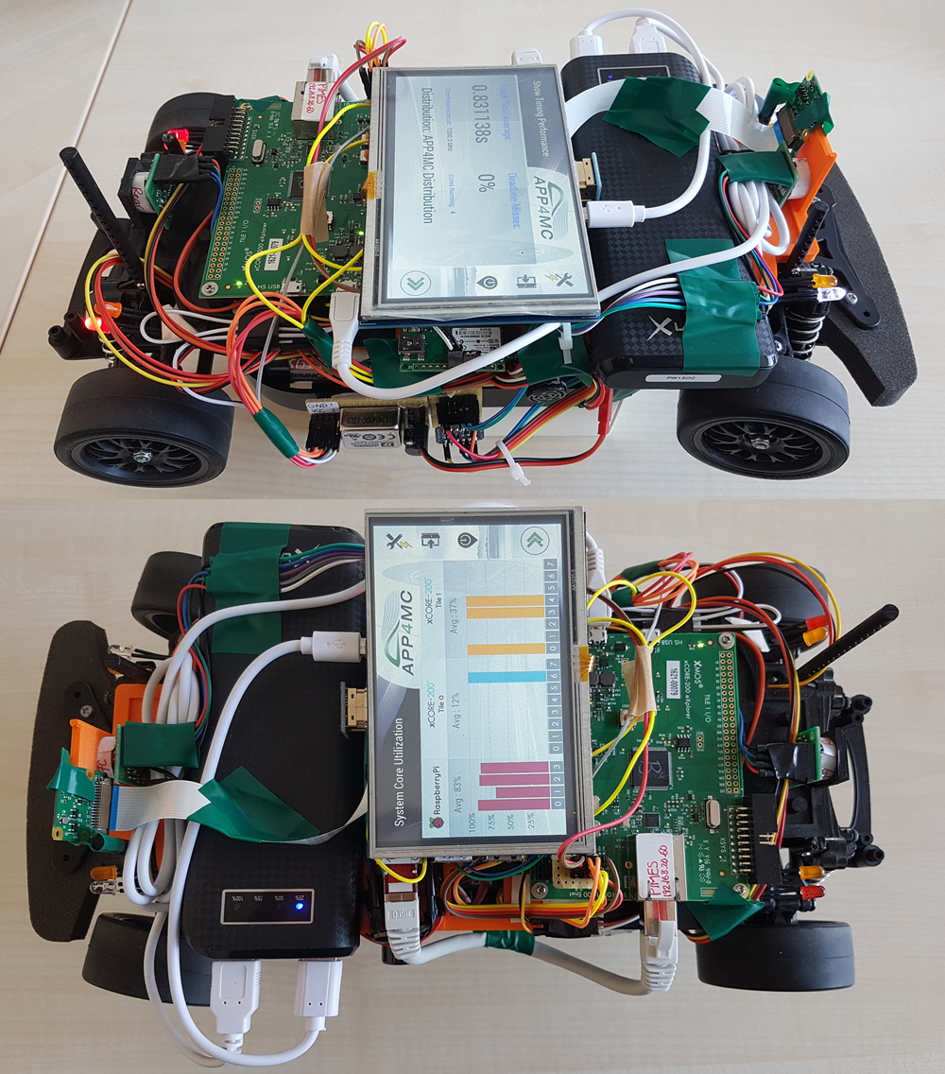
Introduction
Overview
APP4MC
Embedded-multicore system design platform
Automotive domain
Sw deployment through Sw and Hw modeling
A4MCAR
Demonstrator to APP4MC
Features schedulable and traceable software
Has many applications
Problem and Solution
Distribute software efficiently between cores, considering optimization goals
As a solution, APP4MC results are evaluated and presented.

Slide 4


Introduction
Motivations
Importance of parallel programming
Evolution of algorithms, applications, and application domains.
Evolution of new trends in parallel computing
Evolution of multi-core processors
Model-based development
Developing open-source!!!

Slide 5
Introduction
Goals and Contributions of A4MCAR
Achieving a base platform for multi-threaded and multi-process development that is schedulable and traceable
Developing scripts / tool support for several platforms including Linux for profiling, tracing and modeling in order to make demonstration with APP4MC easier.
Researching to achieve better software utilization through APP4MC in order to get lower energy consumption.
Finding out evaluation metrics and methods for parallel software evaluation using real-time and offline (using e.g. TraceCompass) approaches.
Evaluation of several software distributions to make experiments regarding parallel software as well as to test and validate the performance of APP4MC.

Slide 6




Introduction
Events and Publications
IDAACS ’17 Paper “Constrained mixed-critical parallelization for distributed heterogeneous systems”
EclipseCon conferences Europe 2016 IoT Day, and France 2017 Unconference.
Eclipse Foundation GmbH Hackathons I and II
International Research Conference Dortmund 2017 Demonstration
Google Summer of Code 2017 successful participation

Slide 7
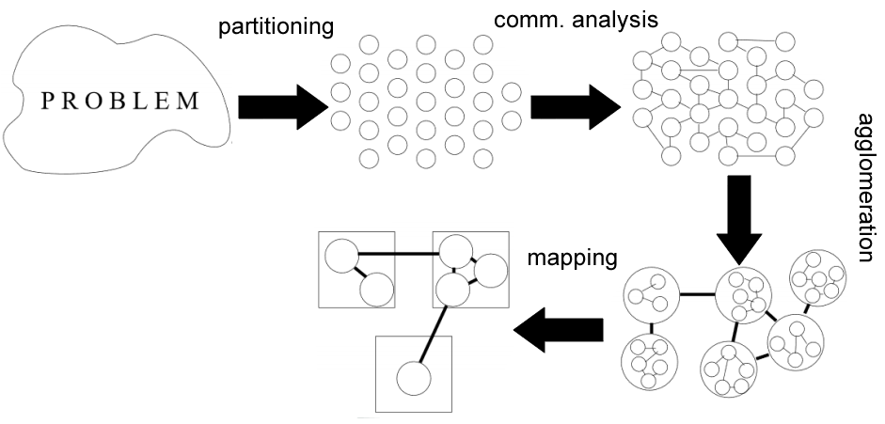
Parallel Programming Basics
Basics
Runnable
Process
Thread
Process vs Thread
Design Techniques

Slide 8
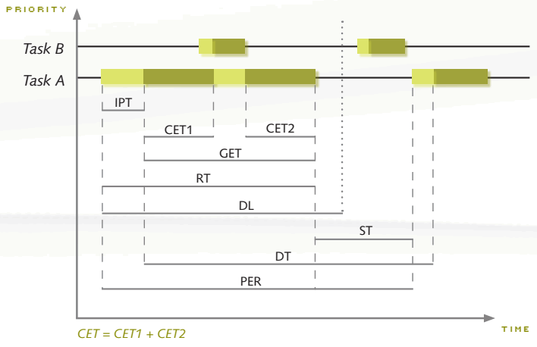
Parallel Programming Basics
Synchronization
Race conditions, deadlock
Mutex
Semaphores
Scheduling Analysis
Interprocess Communication
Shared memory comm.
Mapped memory
Process semaphores
FIFOs
Pipes
Sockets
used
used
for job queues,
used rarely
used
used

Slide 9
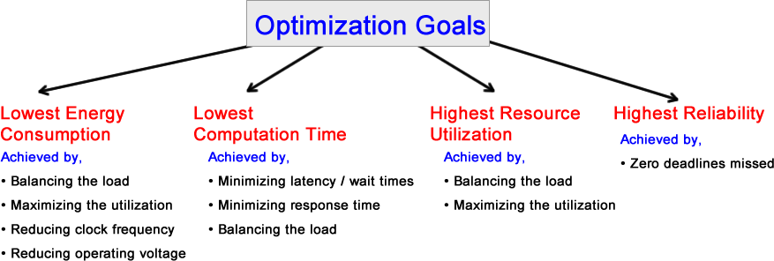
Parallel Programming Basics
Optimization

Slide 10
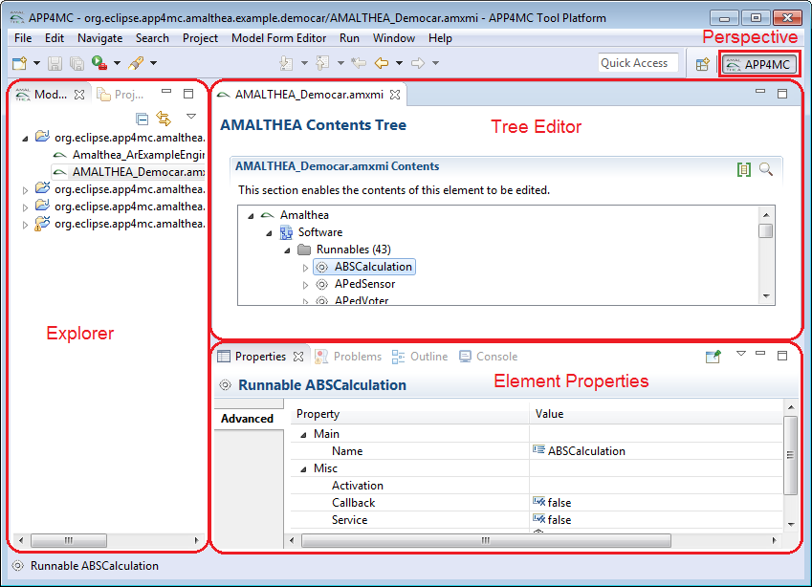
APP4MC
What is APP4MC?
Design Flow with APP4MC
Modeling
AMALTHEA models
Partitioning
ESSP, CPP
Generating Tasks
Mapping
ILP-based, GA-based load balancing
Reducing computation time
Optimization towards energy consumption

Slide 11
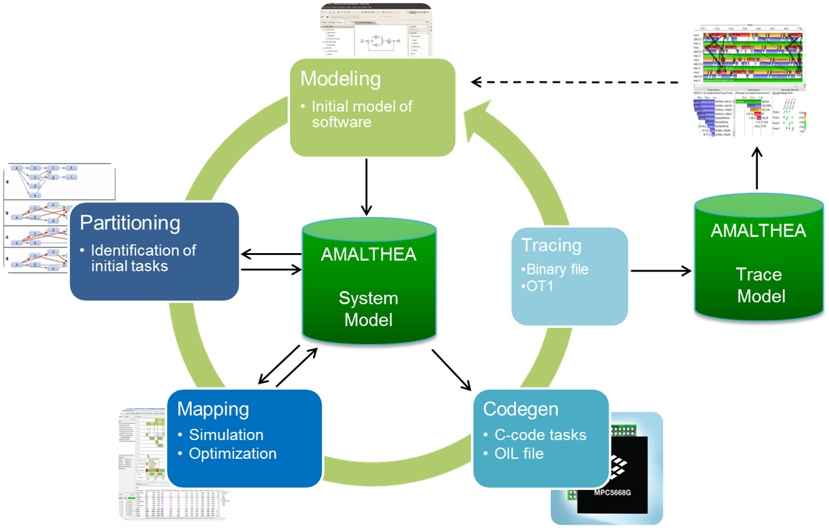
APP4MC
Design Steps

Slide 12
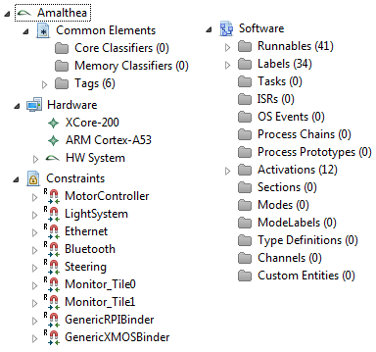
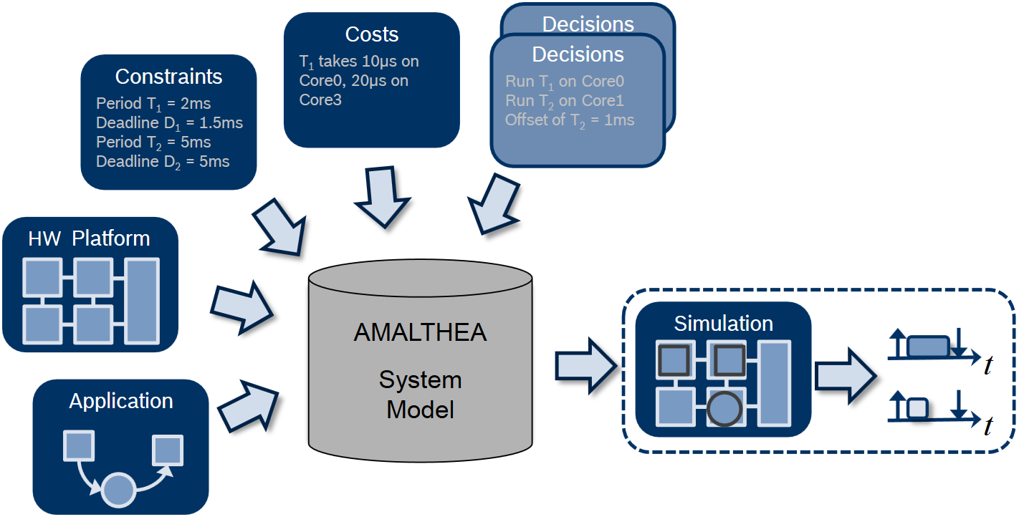
APP4MC
Modeling
XML-based AMALTHEA model

Slide 13
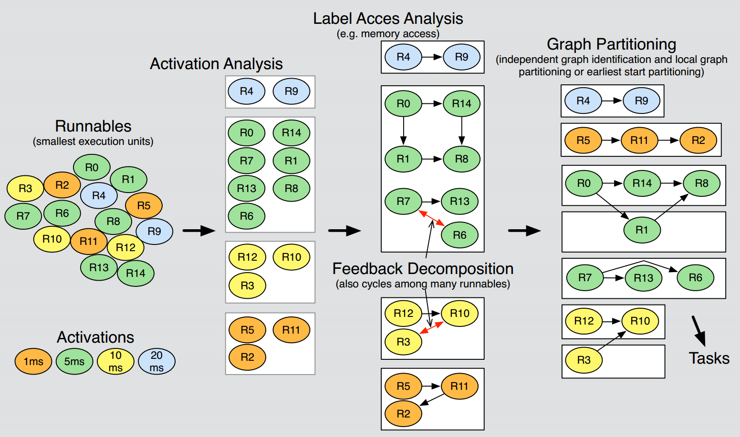
APP4MC
Industrial Use Case of Graph Theory in APP4MC
(image from Robert Höttger, ESM DPS WS 2015/2016, FH Dortmund)

Slide 14
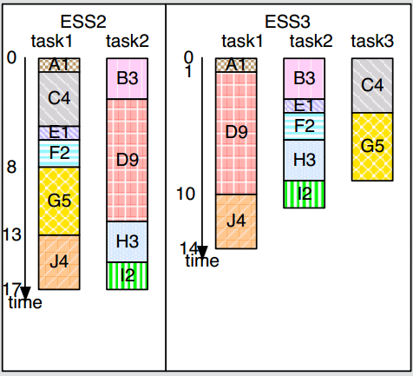
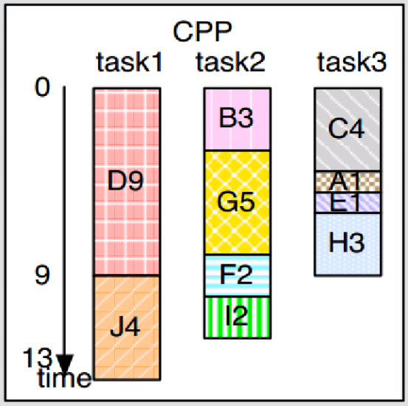
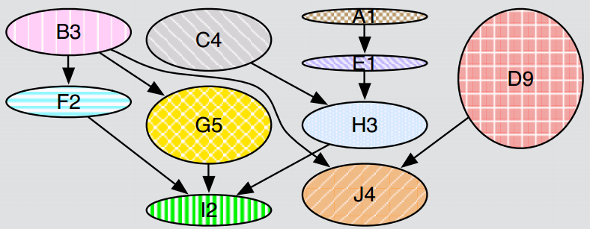
APP4MC
Partitioning
Options: ESSP, CPP
ESSP:
Greedy algorithm.
Nodes assigned to a task that minimizes overall schedule length.
CPP:
Identifies CP first.
Then assigns tasks afterwards to an unbounded number of tasks.
(images from Robert Höttger, ESM DPS WS 2015/2016, FH Dortmund)
Notes:
ESSP is a Greedy algorithm. The algorithm considers more, but basically minimizing SLR is correct. Is *bounds* the number of tasks.
CPP indentifies CP first and assigns tasks afterwards to an *unbounded* number of tasks. _tf_ calculation is necessary to retain all (or not violate any) order precedences.

Slide 15
APP4MC
Mapping
Allocation of
Tasks to cores
Data and labels to memory
Options:
ILP-based, GA-based load balancing
Goals:
Reducing computation time (main concern)
Optimization towards energy consumption

Slide 16
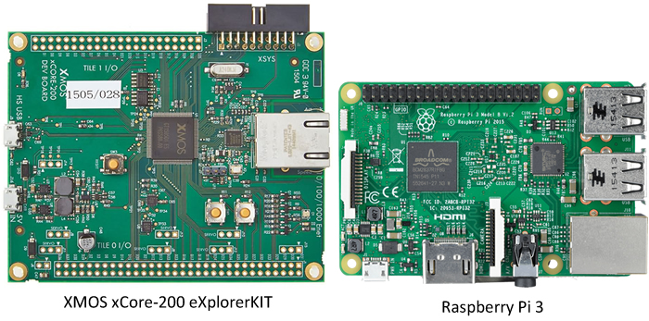
Design and Implementation of A4MCAR
Introduction
Two multi-core controllers
Apps such as:
Android phone/bluetooth control, web interface front-end, Touchscreen display, Sensor applications, Image processing

Slide 17
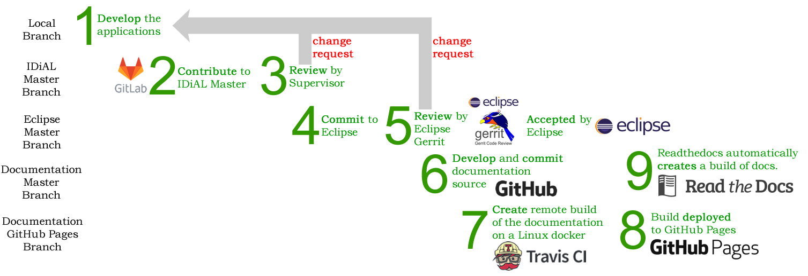
Design and Implementation of A4MCAR
Development Workflow
Open-source development workflow for A4MCAR
http://mozcelikors.github.io/a4mcar

Slide 18
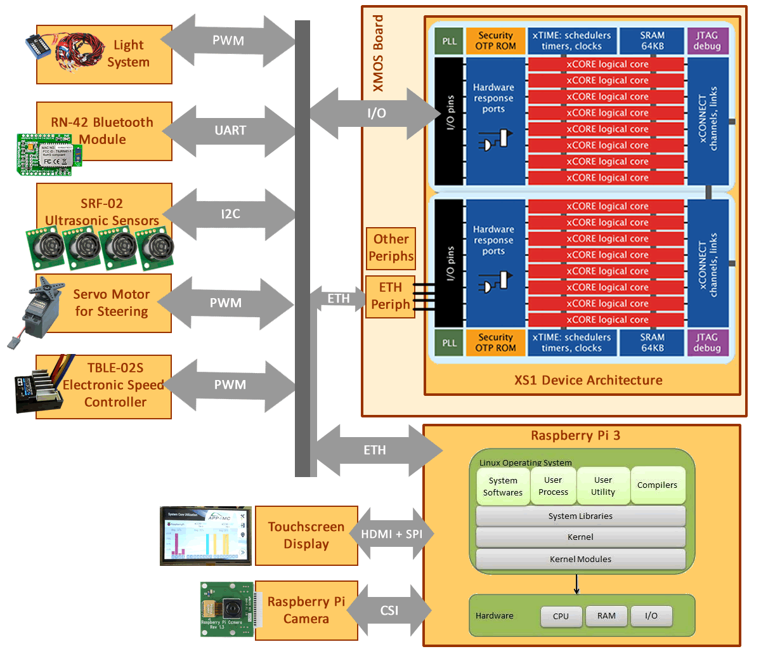
Design and Implementation of A4MCAR
Overall Look to A4MCAR
Hardware
Low-level Module
XMOS xCORE eXplorerKIT
4x SRF-02 Sonar Sensor
TBLE-02S Speed Controller
Servo Motor for Steering
RN-42 Bluetooth Module
Lighting Module
High-level Module
Raspberry Pi (Raspbian/Linux)
Touchscreen Display (HDMI+SPI)
Rpi Camera

Slide 19
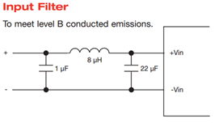
Design and Implementation of A4MCAR
Overall Look to A4MCAR
Safety Considerations
Properly reverse engineering TBLE-02S Electronic Speed Controller
3V to 5V logic converters (I2c-tolerant)
Boards and other components are isolated by using seperate batteries. (7.2V and 5V)
Isolated 5V converter
Emission specification conformed
Implemented proper braking for a brushed motor using a relay switch

Slide 20
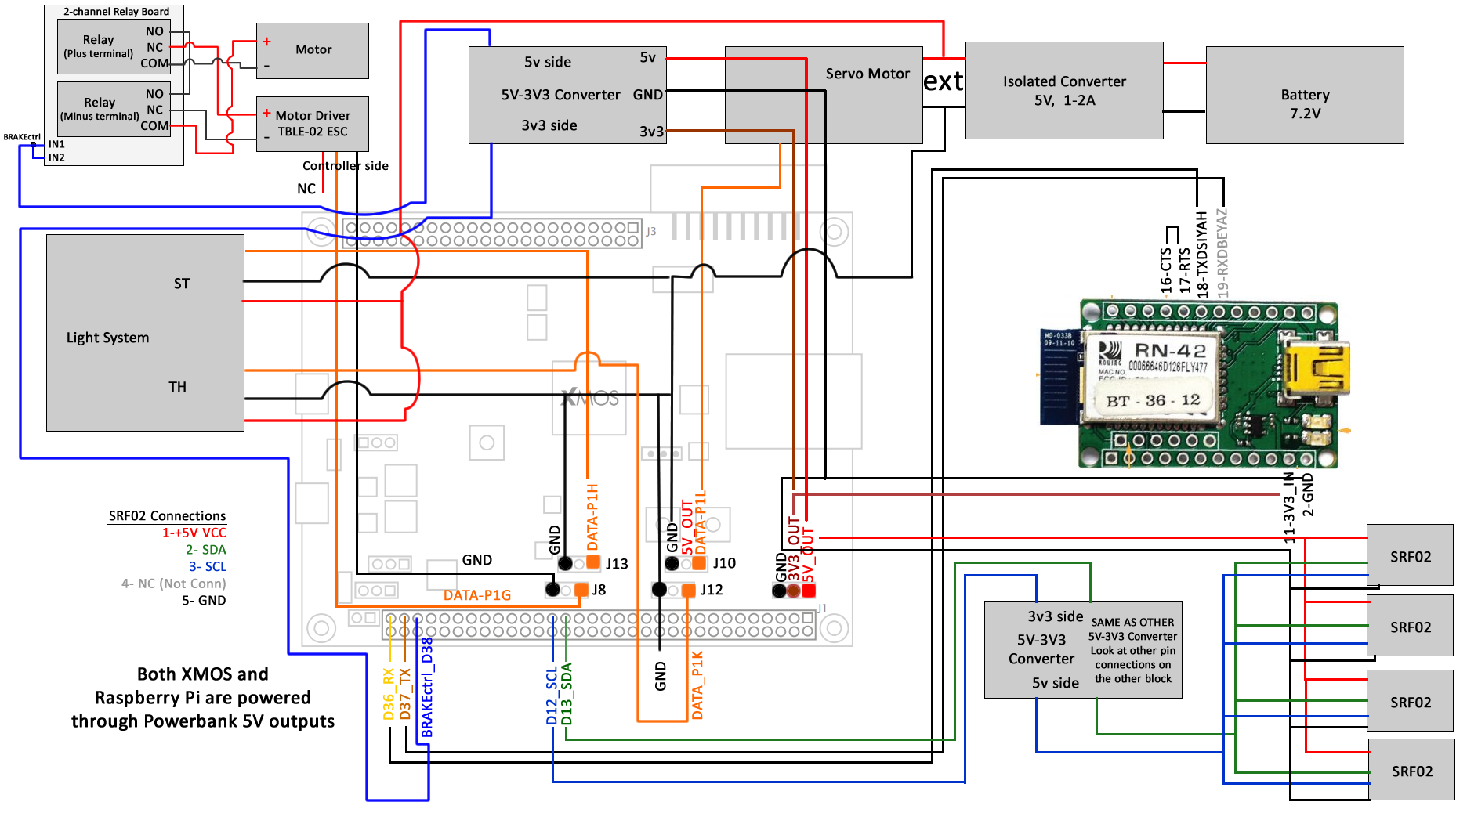
Design and Implementation of A4MCAR
Overall Look to A4MCAR
Hardware Schematics

Slide 21
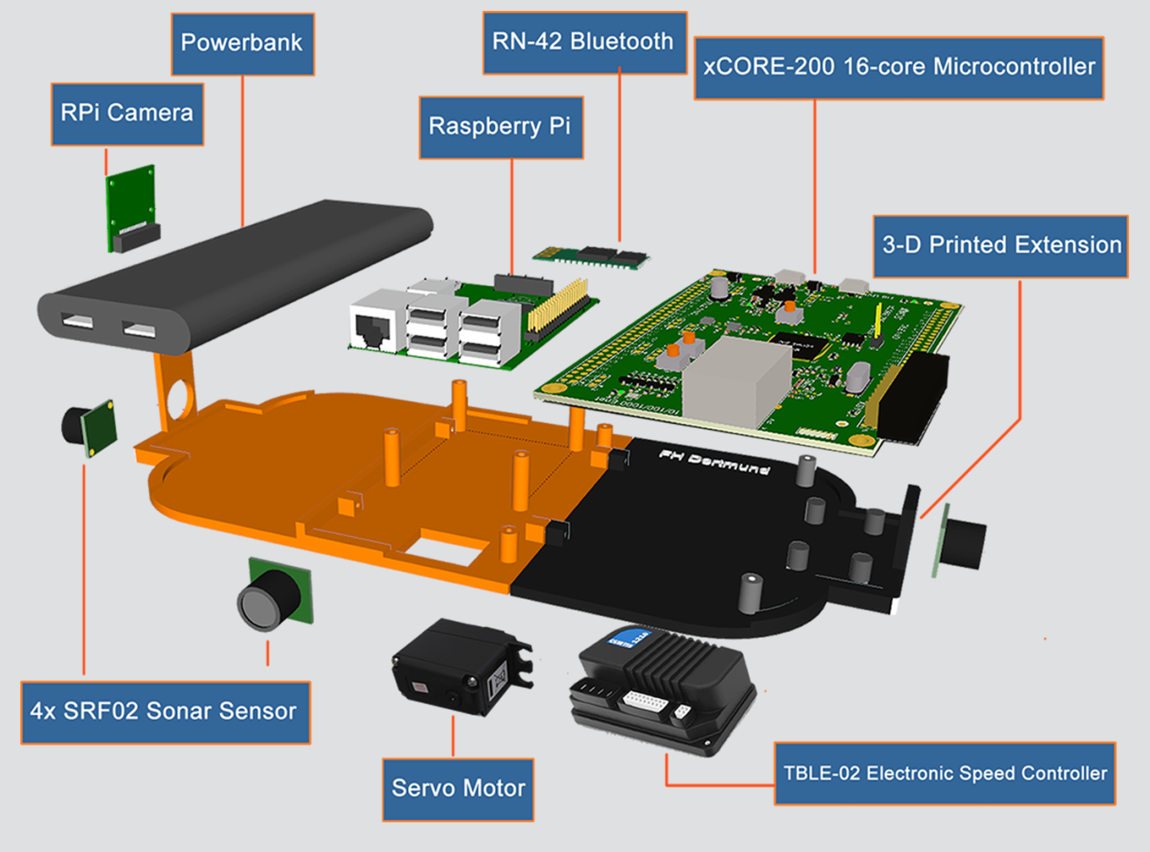
Design and Implementation of A4MCAR
Overall Look to A4MCAR
Mechanical Design
.STL output from 3D design software
3D printed layer

Slide 22
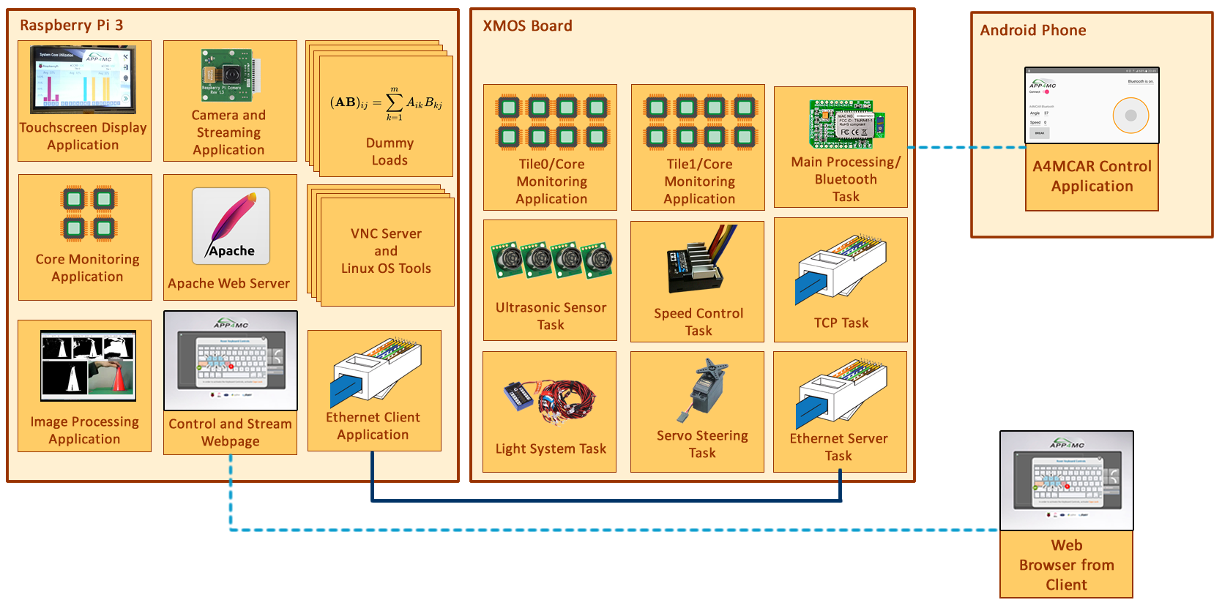
Design and Implementation of A4MCAR
Overall Look to A4MCAR
Software

Slide 23
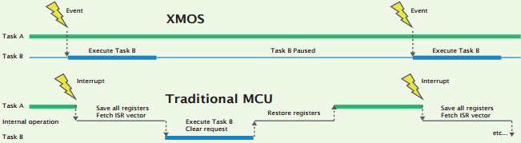
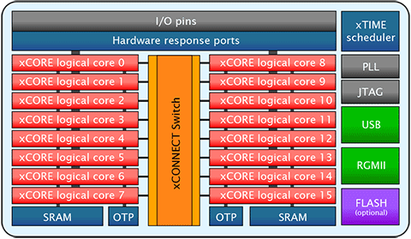
Design and Implementation of A4MCAR
How does Infrastructure look like?
xCORE-200 16-core microcontroller
XMOS / xTIME Scheduler
Round robin
Traditional MCU /RTOS
Tile 0
Tile 1

Slide 24
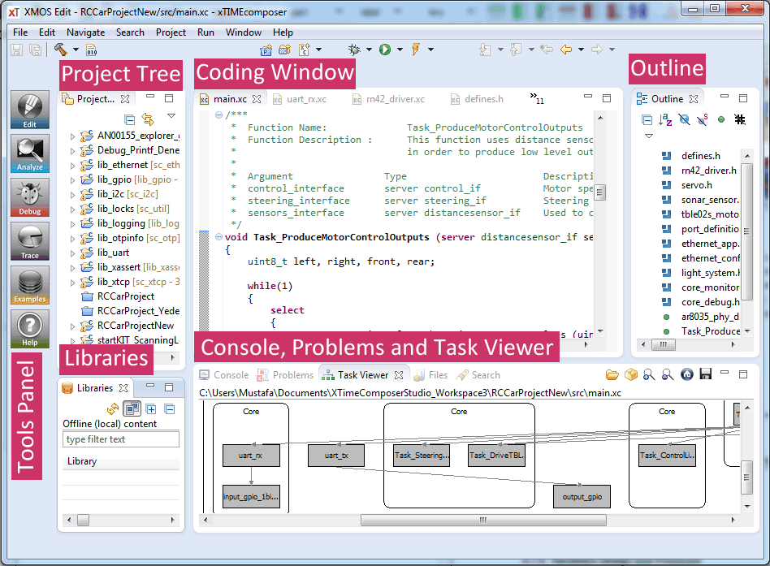
Design and Implementation of A4MCAR
How does Infrastructure look like?
xCORE-200 16-core microcontroller
xTIME Composer

Slide 25
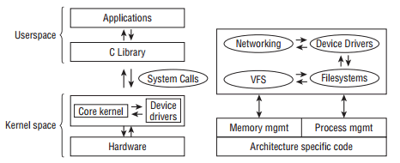
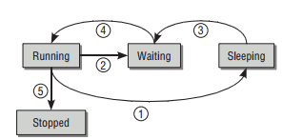
Design and Implementation of A4MCAR
How does Infrastructure look like?
Raspberry Pi (Raspbian/Linux)
GNU/Linux Architecture
Process/Thread Lifecycle
Completely Fair Scheduling
(CFS)
(not Real-Time due to
Equal time slices)

Slide 26
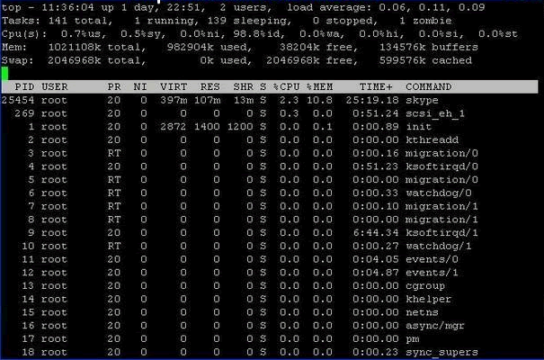
Design and Implementation of A4MCAR
How does Infrastructure look like?
Raspberry Pi (Raspbian/Linux)
Developing in Raspberry Pi
SSH connection from PC
PuTTy (Shell)
TightVNC (Desktop)
Eclipse IDE (Remote Compilation/Debugging)
Editors
Any GNU/Linux Terminal software
Eclipse IDE
Emacs (Powerful dev. Env.)

Slide 27
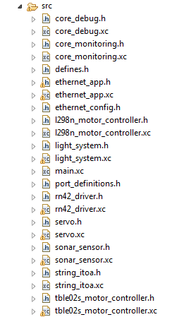
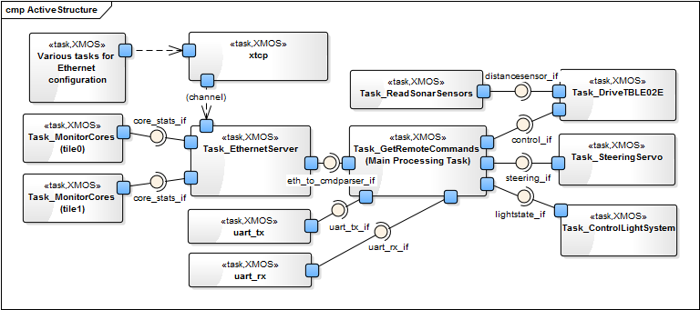
Design and Implementation of A4MCAR
Low-level Module Tasks
Overview

Slide 28
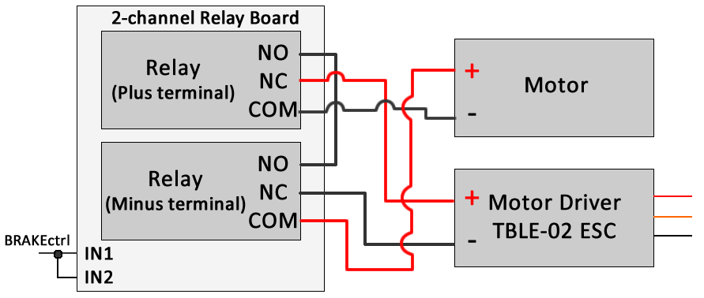
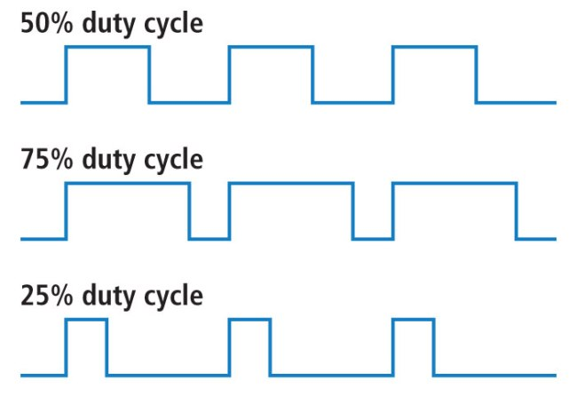
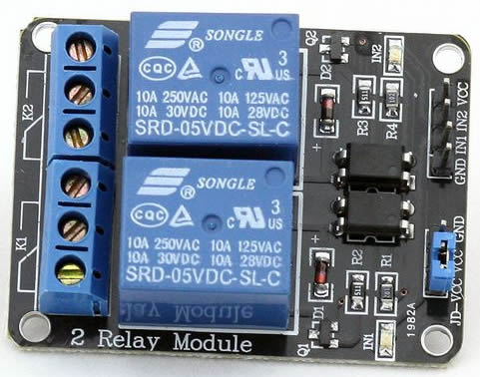
Design and Implementation of A4MCAR
Low-level Module Tasks
Acceleration/Braking
PWM-based ESC drive
Timer event in XMOS
20ms pulse period
Relay-based braking

Slide 29
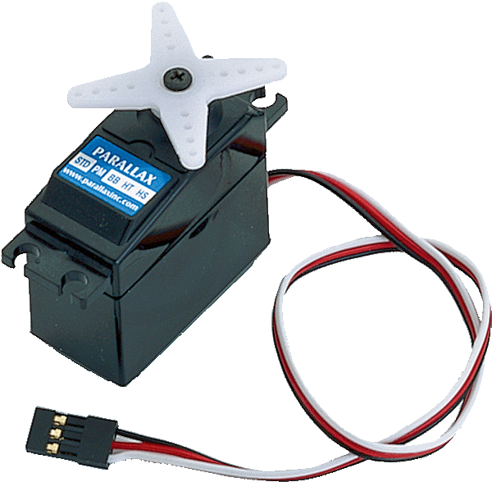
Design and Implementation of A4MCAR
Low-level Module Tasks
Steering
Servo motor
Driven with PWM pulse
Timer event in XMOS
20ms pulse period
1-1.5ms -> Left side
1.5ms-2.0ms -> Right side

Slide 30
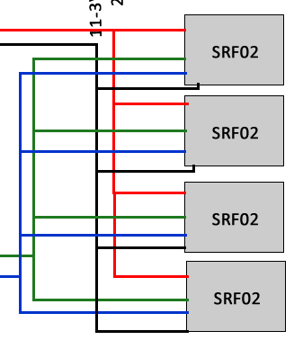
Design and Implementation of A4MCAR
Low-level Module Tasks
Proximity Sensing
SRF-02 Ultrasonic Sensor
I2C network with 4 sensors
Periodically polling information (0.2 sec)
Timer event
VCC
GND
SDA
SCL

Slide 31
Design and Implementation of A4MCAR
Low-level Module Tasks
Light System
Lighting module from Conrad
PWM-driven
Specified pulses are applied.

Slide 32
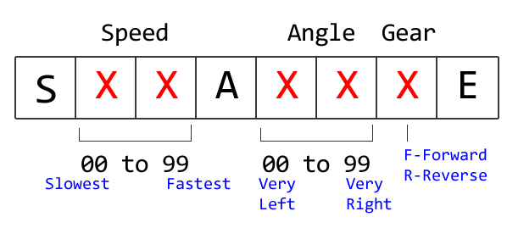
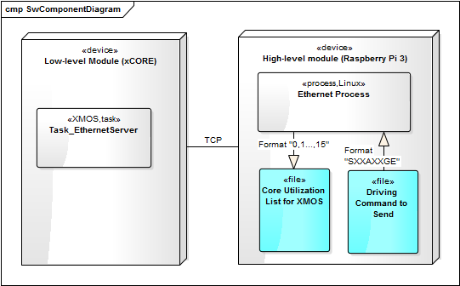
Design and Implementation of A4MCAR
Low-level Module Tasks
Bluetooth Task
RN-42 Bluetooth module
Communicates using UART
Slave mode
Configuration function implemented (pwd).
Events in Task:
Timer event to process received command
UART ready event
Override command event

Slide 33
Design and Implementation of A4MCAR
Low-level Module Tasks
TCP Server Task
Many concurrent tasks implement PHY driver and TCP protocol
TCP Server task
Periodically sends core information to HLM
Receives when HLM sends a driving command

Slide 34
Design and Implementation of A4MCAR
Low-level Module Tasks
Core Monitoring Task
Instantiated for two seperate tiles.
Timer event polls internal registers for each core to see if cores are busy
Averaging over time gives reasonable core util information
Counters for busy and idle cycles are used.

Slide 35
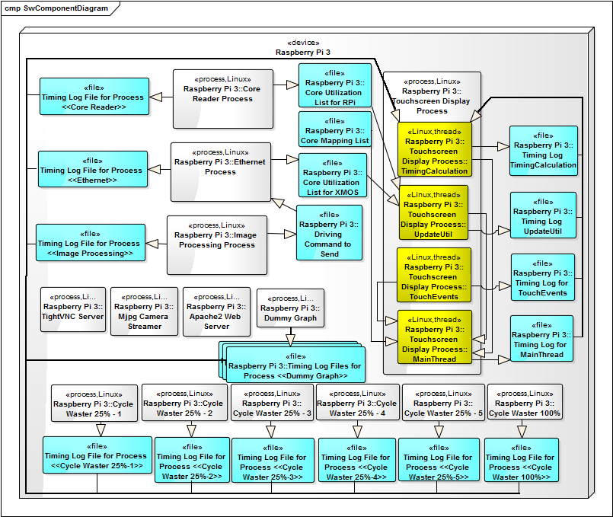
Design and Implementation of A4MCAR
High-level Module Tasks
Overview

Slide 36
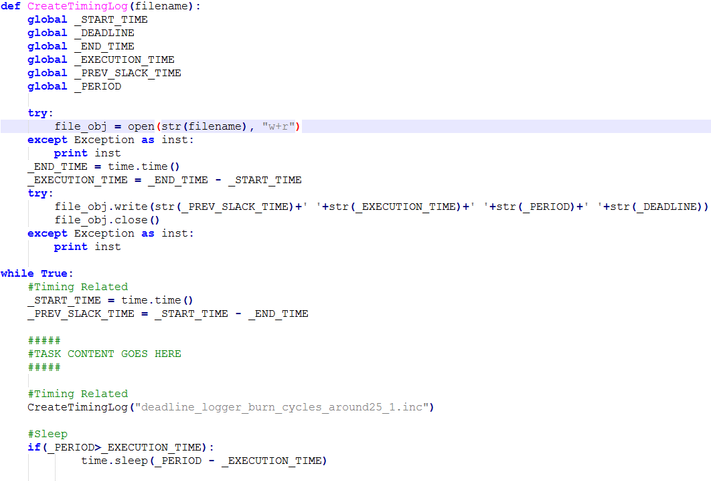
Design and Implementation of A4MCAR
High-level Module Tasks
Overview
Schedulability and traceability (in C++ and Python)

Slide 37
Design and Implementation of A4MCAR
High-level Module Tasks
1. Core Reader
Uses 3rd party: ‘psutil’ package from Python
Logs each core utilization
2. TCP Client
Uses Python’s ‘socket’ library
Non-blocking receive
Periodically (every 3s) transmit
Uses logs to write and read infos

Slide 38
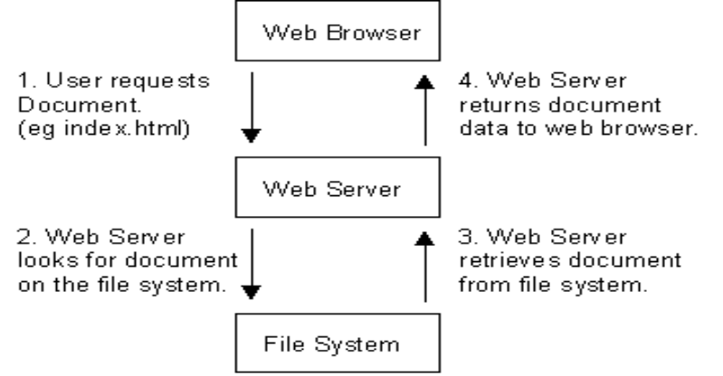
Design and Implementation of A4MCAR
High-level Module Tasks
3. Web Server (apache2)
Responsible for processing HTTP requests
Delivering HTTP responses
HTML, CSS, JavaScript – based web pages
PHP-based server pages and databases

Slide 39
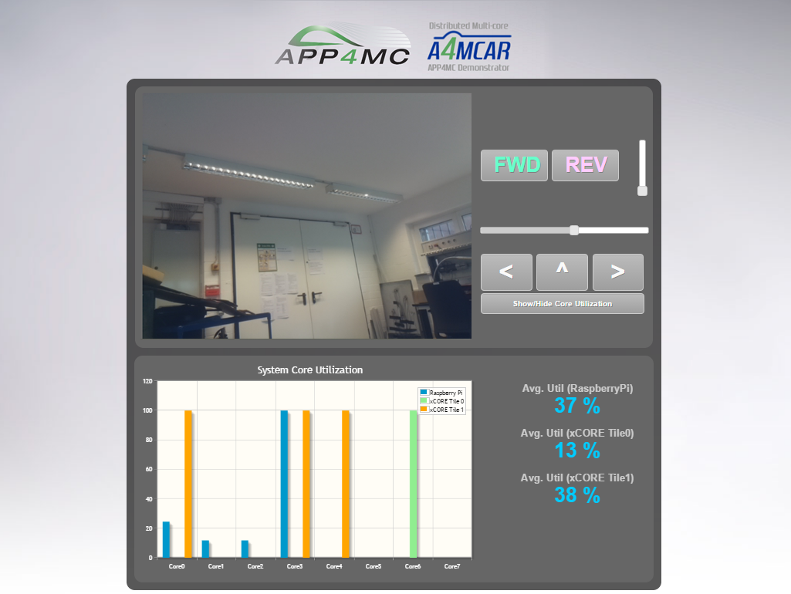
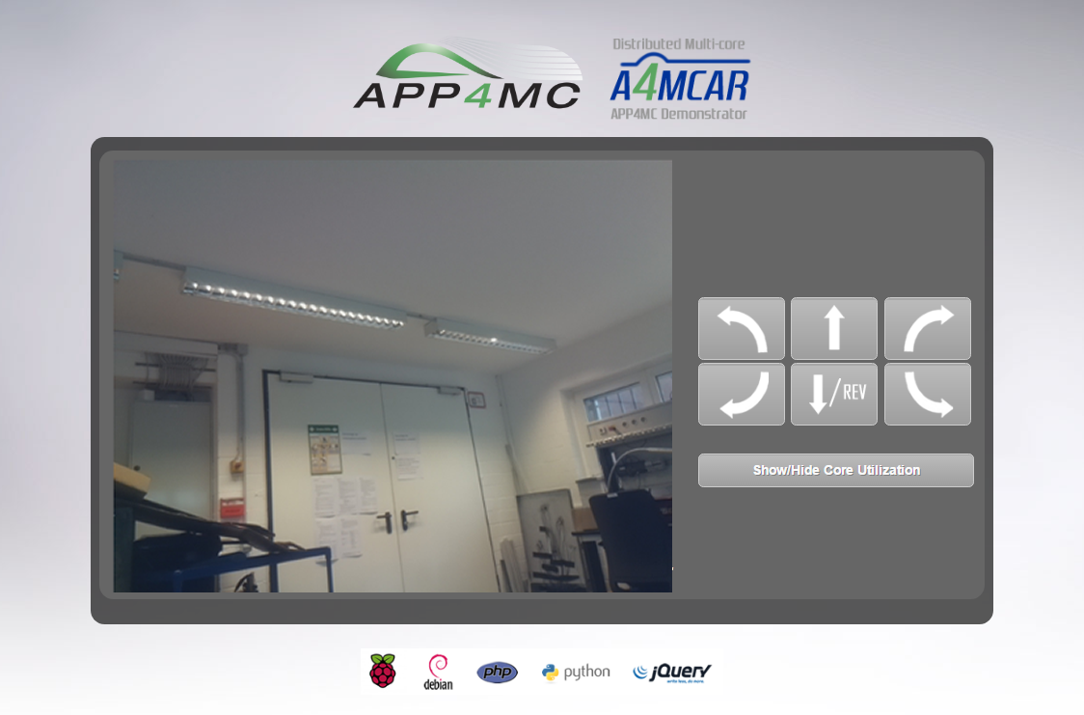
Design and Implementation of A4MCAR
High-level Module Tasks
3. Web Server (apache2)
Web Front-End Design and Implementation
Technologies Used: HTML, CSS, PHP, JavaScript, AJAX, jQuery, Python

Slide 40
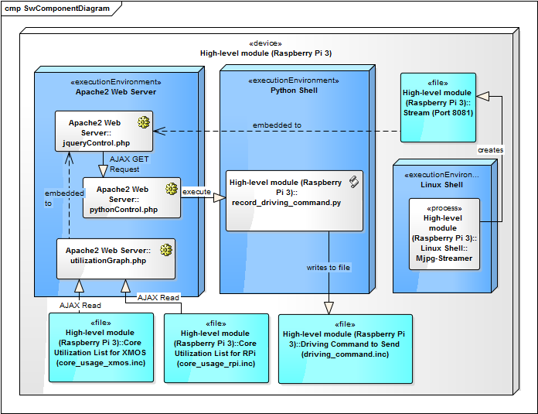
Design and Implementation of A4MCAR
High-level Module Tasks
3. Web Server (apache2)
Controlling A4MCAR via Web interface

Slide 41
Design and Implementation of A4MCAR
High-level Module Tasks
3. Web Server (apache2)
Core Utilization Display
jqPlot

Slide 42
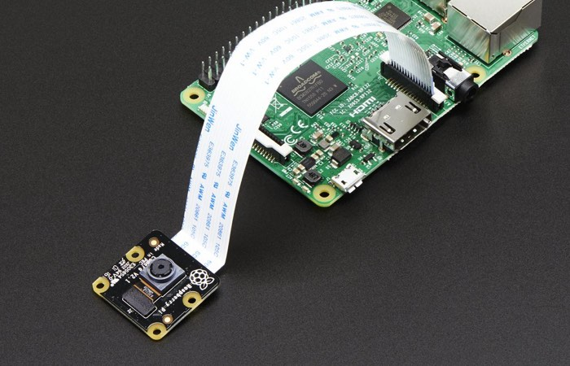
Design and Implementation of A4MCAR
High-level Module Tasks
4. Camera Streaming
mjpg_streamer
Experimental streaming for Raspicam
Resolution: 640 x 480
Fps : 30
Bash script to start

Slide 43
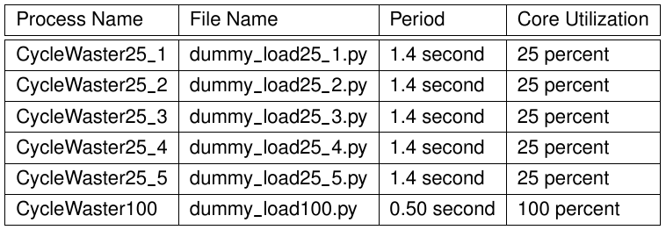
Design and Implementation of A4MCAR
High-level Module Tasks
5. Dummy Loads
Random matrix multiplication 1000 x 1000
Different task periods 0.5s to 1.4s

Slide 44
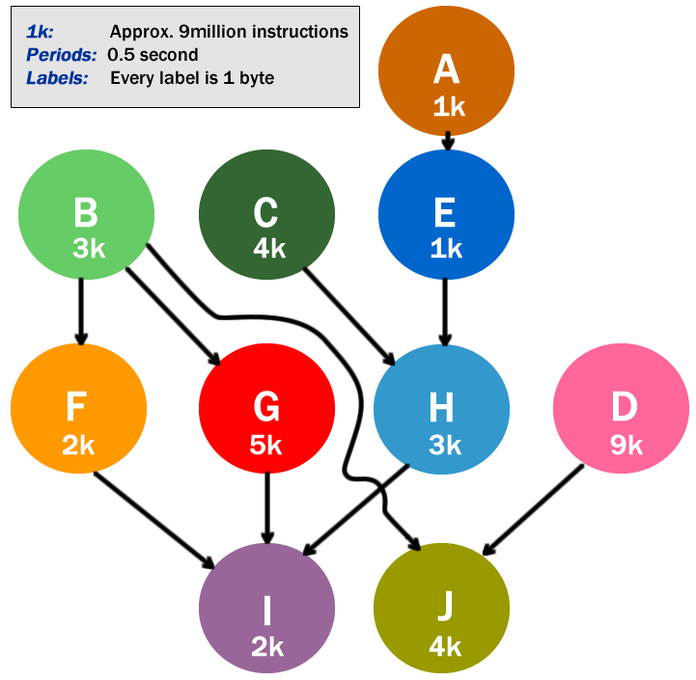
Design and Implementation of A4MCAR
High-level Module Tasks
6. Dummy Graph
Multi-threaded
Python “threading”
Each node is a thread
To demonstrate “partitioning”
1k = 200 x 200 matrix multiplication
= 9 million instructions

Slide 45
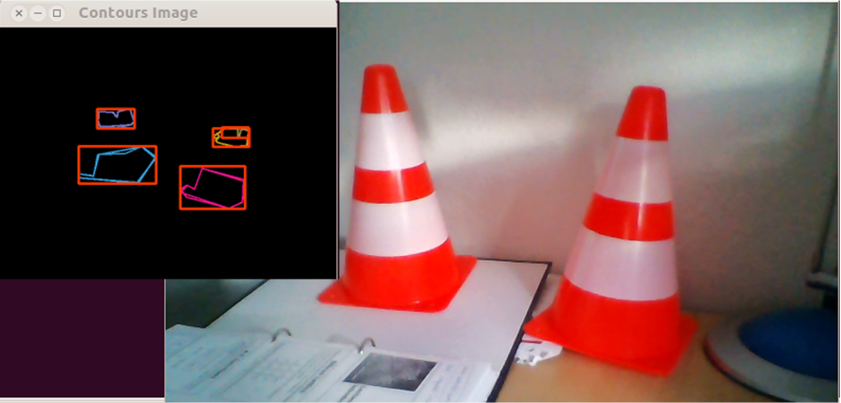
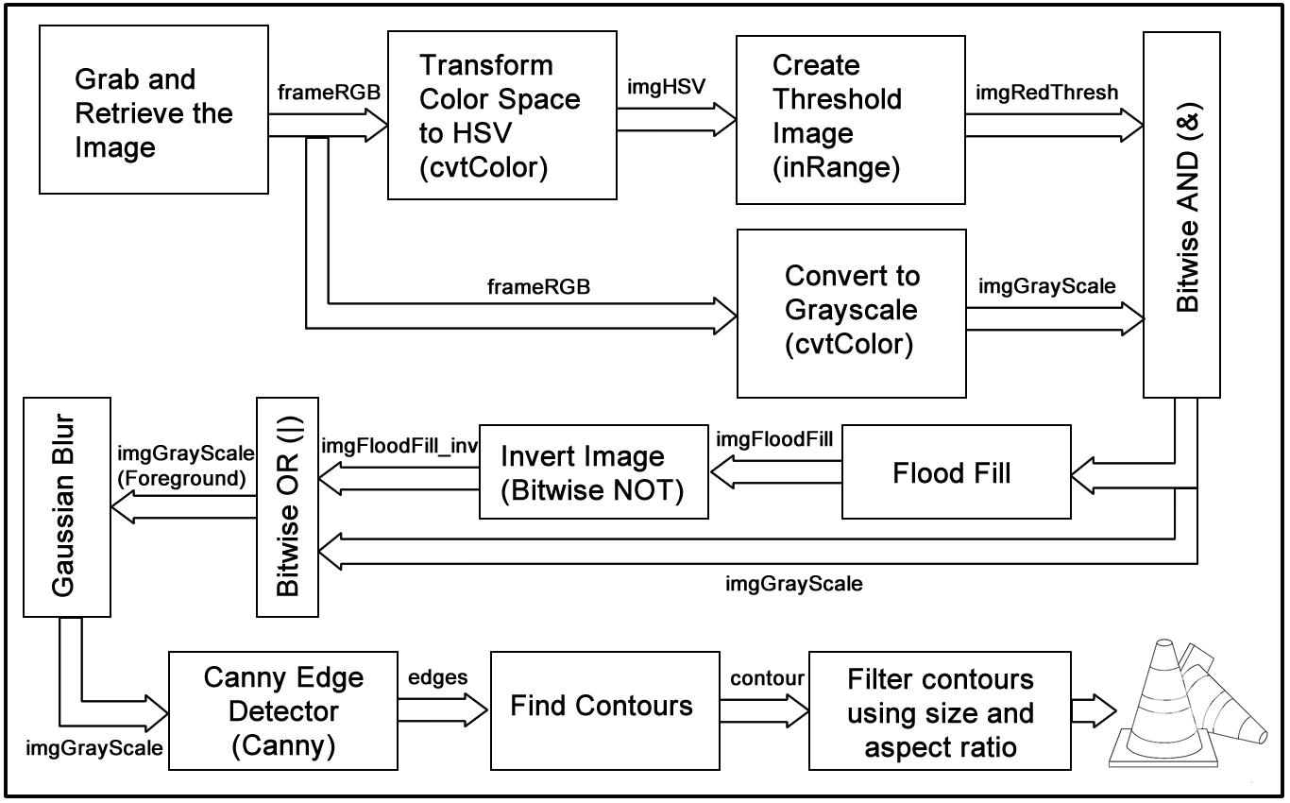
Design and Implementation of A4MCAR
High-level Module Tasks
7. Image Processing
C++, OpenCV 2.6
Traffic Cone Detection
Based on contour detection
When found, indicates on screen

Slide 46
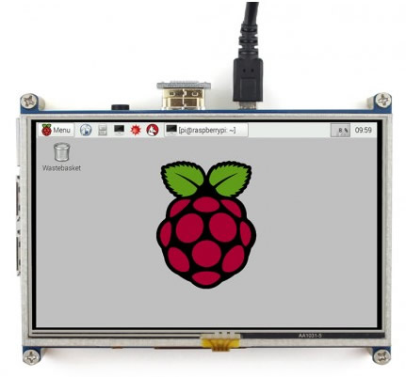
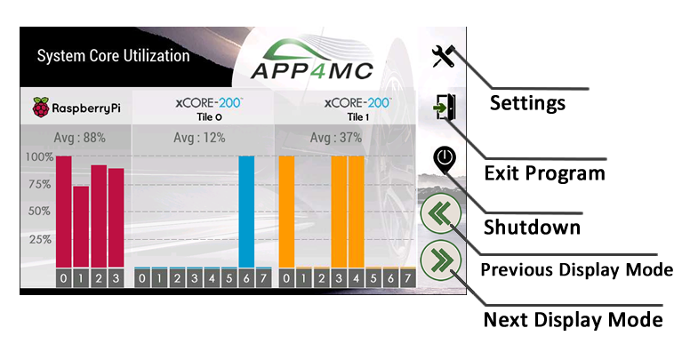
Design and Implementation of A4MCAR
High-level Module Tasks
8. Touchscreen Display
Waveshare 5” 800x480 HDMI+SPI
installed, calibrated on Raspberry Pi.
Python’s pygame framework used.
Interface graphics and behavior designed.
Multi-threaded design for touchscreen event
responsiveness.

Slide 47
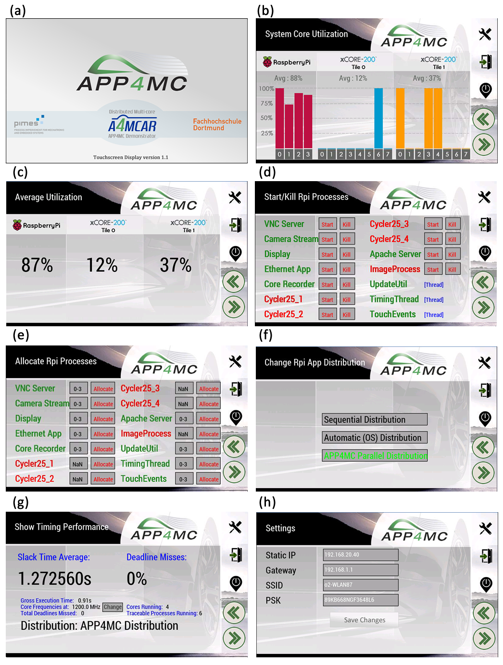
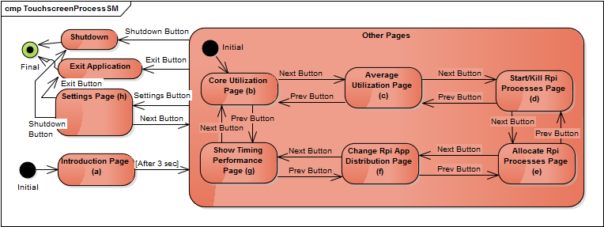
Design and Implementation of A4MCAR
High-level Module Tasks
8. Touchscreen (cont.)
Functionality
Core visualization
Average util. Display
Process handling
Process allocation
Distribution selection
Timing performance
Shows STavg, DM, GET, fclk etc..
Device settings

Slide 48
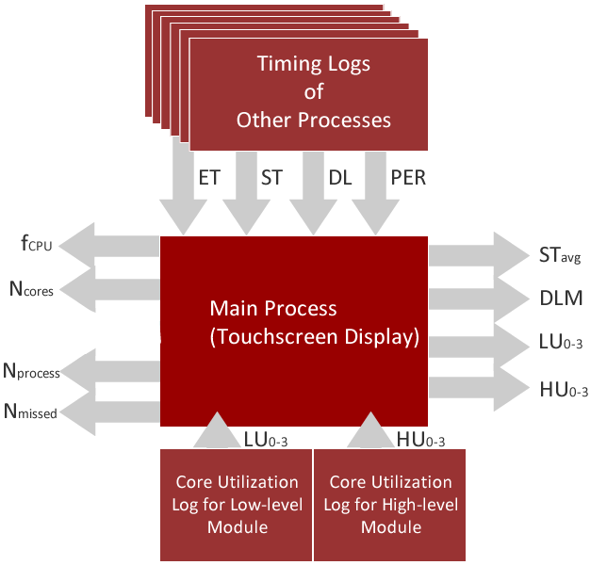
Design and Implementation of A4MCAR
High-level Module Tasks
8. Touchscreen (cont.)
Efforts
Process, thread handling library written in Python
Thread and process names registered to kernel for tracing
Timing info is logged for each thread.
(will be explained later on.)

Slide 49



Design and Implementation of A4MCAR
Android Application
Bluetooth communication
Pairing, pwd authentication
Connects to RN-42 module
Implemented & integrated
joystick
Used
Android Studio,
Java and XML languages

Slide 50
Contents
Introduction
Overview
Problem and Solution
Motivations
Goals and Contributions
Events and Publications
Parallel Programming Basics
Definitions
Design Techniques
Synchronization
Scheduling Analysis
Optimization
APP4MC
Design and Implementation of A4MCAR
Overall Look
Development Workflow
Basic Infrastructure
Low-level Applications
High-level Applications
Web Interface
Android App
Efforts Toward Tracing
Efforts Toward Software Distribution
Reducing Power Consumption
Results
Distributions
Comparison
Conclusions

Slide 51
Efforts Toward Tracing
Gathering Information
to Model with AMALTHEA
Static Binary Analysis
Without executing the code
Instruction size (granularity) etc.
Platform info + binary = timing estimations
In Linux: gcc –Wall –pedantic, objdump (disassembly), gdb, perf
Profiling (Dynamic Analysis)
By executing the code on real CPU
Find events, timing, instruction information
In Linux: gprof, perf
Tracing
Logging with timestamps
Chronological information of execution
In Linux: perf, lttng, trace-cmd, /proc filesystem
System Monitoring
Monitoring events, processes, threads
In Linux: ps, top, psutil, /proc filesystem, strace, custom scripts.

Slide 52


Efforts Toward Tracing
XMOS’s XTA Tool for Binary Analysis
To get granularity information for AMALTHEA
Non-deterministic tasks are left unexamined.
We check disassembly in that case.

Slide 53

Efforts Toward Tracing
XMOS’s XTA Tool for System Monitoring
To see resource consumption from binary

Slide 54

Efforts Toward Tracing
XMOS – Developed core utilization reader
(Unfortunately, comes with limitations)
Only gives valid information on
Specific kind of periodic tasks

Slide 55
Efforts Toward Tracing
Linux’ objdump for Binary Analysis of Instructions
To see dissassembly, count instructions
objdump myobject .o –S > myDump.txt
Python’s dis library for Binary Analysis of Instructions
To see dissassembly, count instructions
import dis
dis.dis()

Slide 56

Efforts Toward Tracing
Linux’ trace-cmd for tracing [Ftrace front-end]
trace-cmd record –e sched
Visualizing trace-cmd trace
kernelshark

Slide 57
Efforts Toward Tracing
Linux’ perf for Dynamic Analysis of Instructions and Traces
Perf: Performance analysis tool
Able to statisically profile entire system or individual processes
Able to dynamically count instructions as program executes
Able to hide overhead as much as possible
Installing perf
apt-get install linux-tools
Functions used in A4MCAR:
Getting granularity of processes
sudo perf stat –e instructions:u –p <pid>
sudo perf stat –e instructions:u –p <pid> --sleep <timeout>
Getting granularity of threads
Sudo perf stat –e --per-thread –e instructions:u –p <pid> -I <timeout>
Recording system traces
sudo perf sched record -- sleep <timeout>
Showing system traces
sudo perf sched script > trace.txt
Sudo perf sched map > trace.txt

Slide 58

Efforts Toward Tracing
Linux’ perf for Tracing
sudo perf sched script > trace.txt

Slide 59

Efforts Toward Tracing
Linux’ perf for Tracing
sudo perf sched map > trace.txt
CPU0
CPU1
CPU2
CPU3
(*: Context switch, migration)

Slide 60


Efforts Toward Tracing
Visualizing perf traces
Common Trace Format (CTF)
Built new linux-tools from a custom Linux kernel source
Built perf with libbabeltrace
perf.data >> ./ctf
Eclipse TraceCompass
Custom scripts

Slide 61



Efforts Toward Tracing
Implementations regarding evaluation metrics

Slide 62

Efforts Toward Software Distribution
In XMOS (xC)
at compile-time
In Linux
At runtime
(combinable tasks)
Class
‘aprocess’
For processes and threads
taskset –pc <coreaffinity> <pid>
To handle
bash and python scripts execute functions.
Executes
taskset
[COREDEF_LIST_APP4MC] Assign Task Xtightvnc To Core 0 Assign Task mjpg_streamer To Core 0 Assign Task touchscreen_display To Core 0 Assign Thread Thread_UpdateCoreUsageInfo To Core 2 ....
Main
Process
.a4p file

Slide 63



Reducing Power Consumption
We used a Clamp Meter
to measure current
Underclocking
cpufrequtils (in Linux)
core frequency registers (in XMOS)
Dynamic Voltage and Frequency Scaling (DVFS)
cpufrequtils
Active Energy Consumption (AEC) modes
halting a core when non-used
used

Slide 64
Results
Limitations and Constrains
Non-exact model
Profiling errors and overheads (perf), System overheads (5%), Invisible OS elements
Sporadic activations are not allowed in APP4MC. Therefore, assumptions are involved.
Strict dependencies in APP4MC’s Partitioning
OS does not ensure dependencies, while APP4MC ensures it.
More dependency-loose bin-packing algorithms are now being developed.
Static scheduling approach
APP4MC -> static scheduling approach, OS -> dynamic scheduling, migration involved
XMOS hardware and tooling limitations
Unresolvable sections of code.
Disassembly counting involved.
Core Utilization tracing using registers are only valid for periodic tasks, and are non-exact.
XMOS Application Functionality vs Transparency
Using third party libraries make it harder to have a traceable, distributable system.
Load-balancing limitations of APP4MC
Partitioning algorithms use activation-dependent grouping
Mapping algorithms focuses on reducing max. Computation time.
New approaches will consider n-stage algorithms to also consider load-balancing.

Slide 65

Results
Low-Level Module Results
Evaluation goal: To fit xCORE applications into APP4MC scope
Parallelization goal = # of cores required exceeded.
Approach = periodic tasks are distributed, sporadic tasks are left undistributed.
For evaluation GET and STavg is calculated, Avg.Util is observed.
For XMOS, APP4MC model needs to be constrained.
i.e. Sporadic tasks are not distributed.
i.e. Functional runnables need to be grouped together.
Otherwise the functionality issues are observed in the distribution execution.
Constrained model gave better timing performance.
Stability problems

Slide 66

Results
Set-up & Distributions
ESSP, 10 partitions, GA

Slide 67

Results
HL Comparison &Evaluation

Slide 68

Results
Traces (from Eclipse TraceCompass)

Slide 69

Results
Traces (from Eclipse TraceCompass)

Slide 70
Results
HL Evaluation Methodology
Evaluation Goal: To compare APP4MC with OS-based performance
Four distributions are created and evaluated, each having different set of processes and threads.
Core-affinities are compared: OS, Sequential, APP4MC
Evaluation metrics involve: STavg, GET, DLM, U, IDD
Observed Results
In three distributions, timing performance OS > APP4MC > Sequential
In one distribution, APP4MC > OS > Sequential
So, achieving better performance with APP4MC is possible, but not guaranteed.
APP4MC results improve power cons. very slightly as opposed to OS.
Lesser context-switching in APP4MC.
OS-based distribution involves fluctiations in power consumption.
Power cons. (Underclocking + Downvoltage) > (Undercloking only)
Huge stability problems in Sequential distribution
Reasoning

Slide 71
Conclusions
Reasoning & Conclusion
A4MCAR has its limitations,
System overheads, profiling overheads, non-exact model, not-so fine-grained runnables.
APP4MC is real-time and ensures causal order.
CFS -> very fair, therefore non real-time.
Using RT patch (preemptRT) in Linux is a solution.
Also, OS does not ensure causal order.
APP4MC targets model-based development for industry applications.
Static scheduling is not the best way to approach Linux systems without low-level RTOS solns.
APP4MC targets more fine-grained, lower-level, higher-scale systems.
In our app, we use process/threads as runnables.
APP4MC’s partitioning only concerned about load-balancing when activation periods are the same.
APP4MC is in development stage,
Non dependency-dependent algorithms are being developed.
N-stage genetic algorithms are being studied for load balanding (as opposed to willy nilly distr.)
Not able to work when threads are sporadically activated.
APP4MC focuses on ideal vision of embedded computing
Automizing parallelization foundations based on model-driven manner, using static scheduling approaches.
To get rid of the non-determinism in parallelization, power consumption.
For more industry applications.
APP4MC is a suggestive, supplementary tool.

Slide 72


Final Words
This work, (A4MCAR, APP4MC)
follows pure open-source development workflow. ( under Google Inc, Eclipse Foundation )
develops certain applications as a demonstrator.
implements necessary tool support for analysis and tracing of applications for APP4MC.
evaluates APP4MC performance and compares it to OS-based performance.
Succeeding work, (APP4MC Rover, APPSTACLE)
extends applications toward Cloud & IoT interaction and services.
uses industry-type automotive OS & HMI.
uses more well-engineered software infrastructure (more homogeneous & fine-grained).

Slide 73
Thanks for Your Attention !

